Slide 1

Module – IV : Software Estimation, Project Management, Project Scheduling
Software Engineering (SE) → CSEN3202 – CSE/BTech/6th Semester → Module-IV → Prepared by : Nilina Bera, CSE, HITK

Slide 2
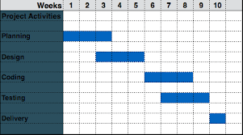
Nilina Bera

Slide 3
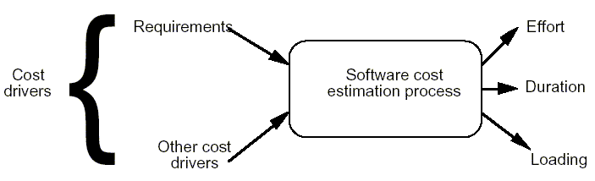
Software Project Planning
The overall goal of project planning is to establish a pragmatic strategy for controlling, tracking, and monitoring a complex technical project.
Why?
So the end result gets done on time, with quality!
Nilina Bera

Slide 4
We have to estimate (Size, Effort, Cost) in Software Project Planning…. Let’s have a look as what’s coming in our way….
1. As the manager of a software project to develop a product for business application, if you estimate the effort required for completion of the project to be 50 person-months, can you complete the project by employing 50 engineers for a period of one month? Justify your answer.
2. For the same number of lines of code and the same development team size, rank the following software projects in order of their estimated development time. Show reasons behind your answer.
• A text editor
• An employee pay roll system
• An operating system for a new computer
Nilina Bera

Slide 5
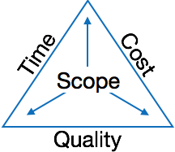
Project Planning Task Set-I
The main goal of software project management is to enable a group of software developers to work efficiently towards successful completion of the project.
Establish project scope
Determine feasibility
Analyze risks
Define required resources
  Determine required human resources
  Define reusable software resources
  Identify environmental resources

Slide 6
WHAT ARE THE STEPS FOR ESTIMATION?
Estimation begins with a description of the scope of the product. The problem is then decomposed into a set of smaller problems and each of these is estimated using historical data and experience as guides.
Responsibilities of a software project manager
Software project managers take the overall responsibility of steering a project to success.
The job responsibility of a project manager ranges from invisible activities like building up team morale to highly visible customer presentations.
Most managers take responsibility for project proposal writing, project cost estimation, scheduling, project staffing, software process tailoring, project monitoring and control, software configuration management, risk management, interfacing with clients, managerial report writing and presentations, etc.
The project planning activity is undertaken before the development starts to plan the activities to be undertaken during development.
The project monitoring and control activities are undertaken once the development activities start with the aim of ensuring that the development proceeds as per plan and changing the plan whenever required to cope up with the situation.
Nilina Bera

Slide 7
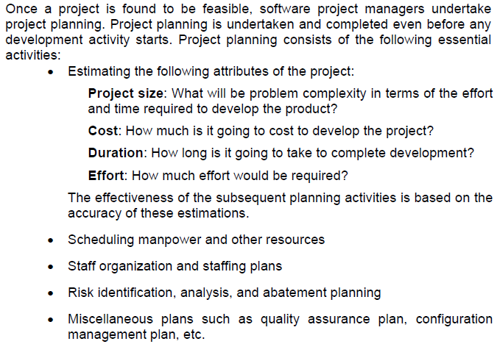
Project planning
Nilina Bera

Slide 8
Categories of Resources
People
Number required
Skills required
Geographical location
Development Environment
Software tools
Computer hardware
Network resources
The
Project
Reusable Software Components
Off-the-shelf components
Full-experience components
Partial-experience components
New components

Slide 9
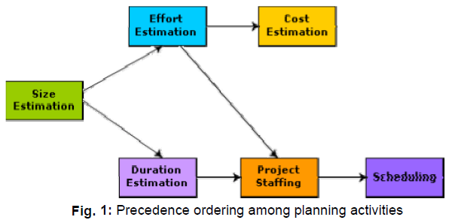
Precedence ordering among project planning activities
Size estimation is the first activity. It is also the most fundamental parameter based on which all other planning activities are carried out. Other estimations such as estimation of effort, cost, resource, and project duration are also very important components of project planning.
Nilina Bera

Slide 10
Sliding Window Planning
In the sliding window technique, starting with an initial plan, the project is planned more accurately in successive development stages.
At the start of a project, project managers have incomplete knowledge about the details of the project.
Their information base gradually improves as the project progresses through different phases.
After the completion of every phase, the project managers can plan each subsequent phase more accurately and with increasing levels of confidence.
Nilina Bera

Slide 11
Project Planning Task Set-II
Estimate cost and effort
  Decompose the problem
  Develop two or more estimates using size, function points, process tasks or use-cases
  Reconcile the estimates
Develop a project schedule
    Establish a meaningful task set
    Define a task network
    Use scheduling tools to develop a timeline chart
    Define schedule tracking mechanisms
Nilina Bera

Slide 12
Estimation
Estimation of resources, cost, and schedule for a software engineering effort requires
  experience
  access to good historical information (metrics)
  the courage to commit to quantitative predictions when qualitative information is all that exists
Estimation carries inherent risk and this risk leads to uncertainty.
Nilina Bera

Slide 13

inherent risk and this risk leads to uncertainty
a) Project complexity
b) Project size
c) The degree of structural uncertainty
d) The availability of historical information
e) Risk
You are estimating safe project work…..
Risk & uncertainty hidden from you…..
Nilina Bera

Slide 14
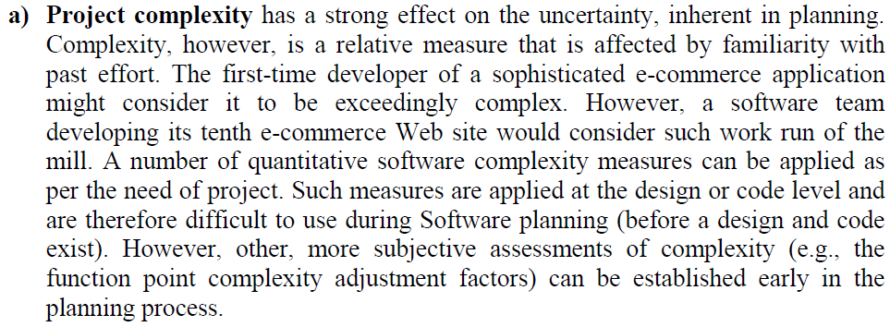
inherent risk and this risk leads to uncertainty
Nilina Bera

Slide 15
Software Estimation
Project Scope
Estimates
Risks
Schedule
Control strategy
Software
Project
Plan
Very Important
Nilina Bera

Slide 16
To Understand Scope ...
Understand the customers needs
understand the business context
understand the project boundaries
understand the customer’s motivation
understand the likely paths for change
understand that ...
Even when you understand,
nothing is guaranteed!
Nilina Bera

Slide 17
What is Scope?
Software scope describes
  the functions and features that are to be delivered to end-users
  the data that are input and output
  the “content” that is presented to users as a consequence of using the software
  the performance, constraints, interfaces, and reliability that bound the system.
Scope is defined using one of two techniques:
    A narrative description of software scope is developed after communication with all stakeholders.
    A set of use-cases is developed by end-users.
Nilina Bera

Slide 18
Software Estimation
WHAT IS ESTIMATION?
Software Engineers are ready to start and the project is about to begin but how do we proceed.
Software project planning encompasses five more activities:
# Estimation
# Scheduling
# Risk analysis
# Quality management planning
# Change management planning
Nilina Bera

Slide 19
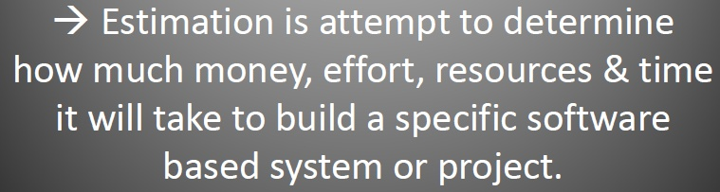
Software Estimation
Your software planning involves estimation—your attempt to determine
How much money,
How much effort,
How many resources,
How much time it will take to build a specific software‐based system or product.
Nilina Bera

Slide 20
Why software project estimation is important?
Would you build a house without
• knowing how much you were about to spend?
• Of course not, and since most computer-based systems
• and products cost considerably more to build
• than a large house, it would seem reasonable to
• develop an estimate before you start creating the software.
Who does estimation ?
Software managers—using information solicited from customers and software engineers
• software metrics data collected from past projects.
Lost project hours account for error on schedule estimation, not size estimation
Remember ➔ Size leads to Effort leads to Schedule
Nilina Bera

Slide 21
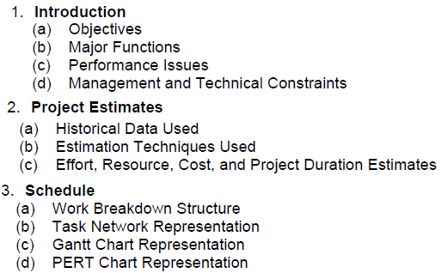
Software Project Management Plan (SPMP)
Once project planning is complete, project managers document their plans in a Software Project Management Plan (SPMP) document. The SPMP document should discuss a list of different items that have been discussed below.
Organization of the Software Project Management Plan (SPMP) Document:
Nilina Bera

Slide 22
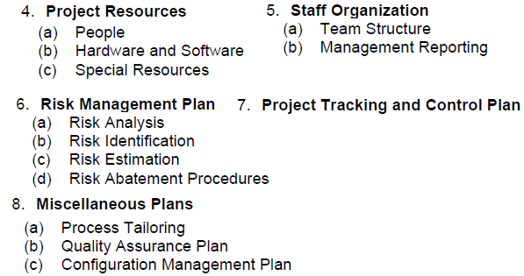

Organization of the Software Project Management Plan (SPMP) Document:
Nilina Bera

Slide 23
Metrics for software project size estimation
Accurate estimation of the problem size is fundamental to satisfactory estimation of effort, time duration and cost of a software project.
In order to be able to accurately estimate the project size, some important metrics should be defined in terms of which the project size can be expressed.
The size of a problem is obviously not the number of bytes that the source code occupies.
It is neither the byte size of the executable code.
The project size is a measure of the problem complexity in terms of the effort and time required to develop the product.
Currently two metrics are popularly being used widely to estimate size: lines of code (LOC) and function point (FP).
Nilina Bera

Slide 24
Lines of Code (LOC)
LOC is the simplest among all metrics available to estimate project size.
Using this metric, the project size is estimated by counting the number of source instructions in the developed program.
Obviously, while counting the number of source instructions, lines used for commenting the code and the header lines should be ignored.
Determining the LOC count at the end of a project is a very simple job.
However, accurate estimation of the LOC count at the beginning of a project is very difficult.
In order to estimate the LOC count at the beginning of a project, project managers usually divide the problem into modules, and each module into sub modules and so on, until the sizes of the different leaf-level modules can be approximately predicted.
To be able to do this, past experience in developing similar products is helpful.
By using the estimation of the lowest level modules, project managers arrive at the total size estimation.
Nilina Bera

Slide 25
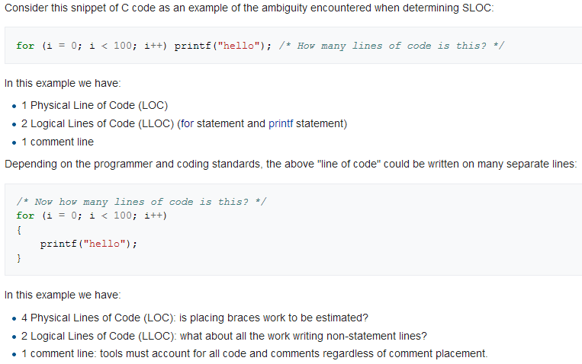

Nilina Bera

Slide 26
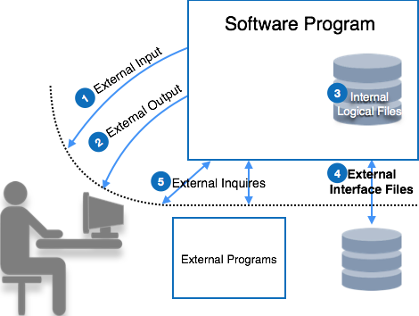
Function point (FP)
Function point metric was proposed by Albrecht [1983].
This metric overcomes many of the shortcomings of the LOC metric.
Since its inception in late 1970s, function point metric has been slowly gaining popularity.
One of the important advantages of using the function point metric is that it can be used to easily estimate the size of a software product directly from the problem specification.
This is in contrast to the LOC metric, where the size can be accurately determined only after the product has fully been developed.
Nilina Bera

Slide 27
Function point (FP)
The conceptual idea behind the function point metric is that the size of a software product is directly dependent on the number of different functions or features it supports.
A software product supporting many features would certainly be of larger size than a product with less number of features.
Each function when invoked reads some input data and transforms it to the corresponding output data.
For example, the issue book feature (fig. 1) of a Library Automation Software takes the name of the book as input and displays its location and the number of copies available.
Thus, a computation of the number of input and the output data values to a system gives some indication of the number of functions supported by the system.
Nilina Bera

Slide 28
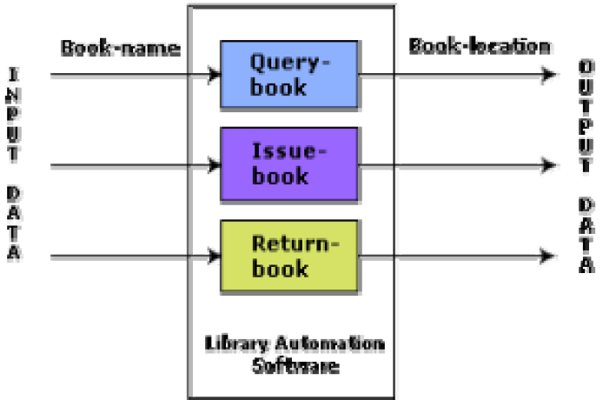
Function point (FP)
fig. 1
Nilina Bera

Slide 29
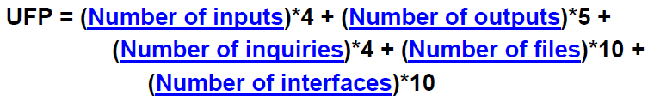
Function point (FP)
Besides using the number of input and output data values, function point metric computes the size of a software product (in units of functions points or FPs) using three other characteristics of the product as shown in the following expression.
The size of a product in function points (FP) can be expressed as the weighted sum of these five problem characteristics.
The weights associated with the five characteristics were proposed empirically and validated by the observations over many projects. Function point is computed in two steps.
The first step is to compute the unadjusted function point (UFP).
Nilina Bera

Slide 30
Function point (FP)
Number of inputs: Each data item input by the user is counted. Data inputs should be distinguished from user inquiries. Inquiries are user commands such as print-account-balance.
Inquiries are counted separately. It must be noted that individual data items input by the user are not considered in the calculation of the number of inputs, but a group of related inputs are considered as a single input.
For example, while entering the data concerning an employee to an employee pay roll software; the data items name, age, sex, address, phone number, etc. are together considered as a single input. All these data items can be considered to be related, since they pertain to a single employee.
Nilina Bera

Slide 31
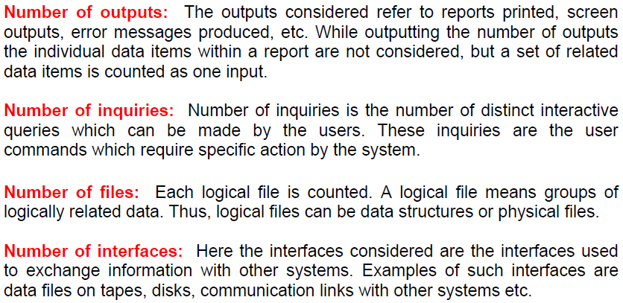
Function point (FP)
Nilina Bera

Slide 32
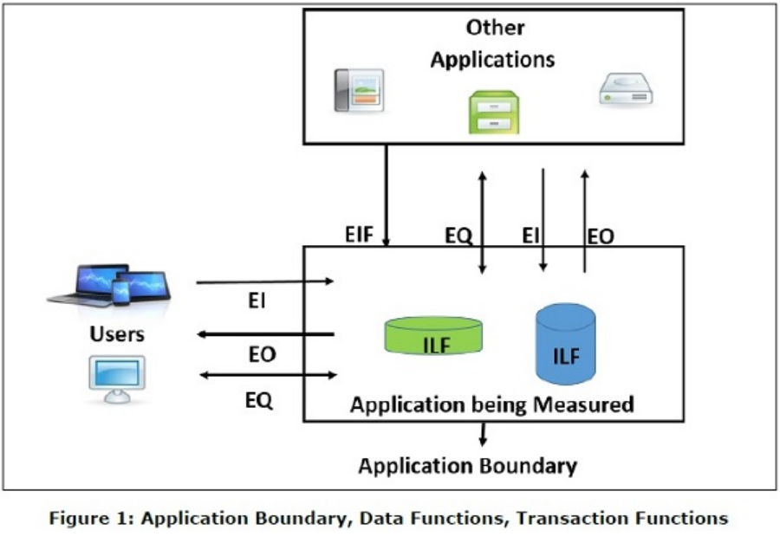
EQ: External Queries
EI: External Input
EO: External Output
# of Internal Logical Files (ILF)
# of External Interface Files (EIF)
Nilina Bera

Slide 33
Advantages of ‘Function Points’ (FP) over ‘Lines of Code’ (LOC) for estimating the size of a software application
a. It can be applied early in the software development life cycle.
b. It is independent of the programming language, technology, techniques.
c. It provides a reliable relationship to effort.
d. Creation of more function points can define productivity goal as opposed to LOC.
e. Productivity of projects written in different languages can be measured.
f. They can be counted early and often.
g. They can be used for GUI systems.
h. It considers environmental factors.
Nilina Bera

Slide 34
Project Estimation techniques
Estimation of various project parameters is a basic project planning activity.
The important project parameters that are estimated include: project size, effort required to develop the software, project duration, and cost.
These estimates not only help in quoting the project cost to the customer, but are also useful in resource planning and scheduling.
There are three broad categories of estimation techniques:
Empirical estimation techniques
Heuristic techniques (COCOMO)
Analytical estimation techniques
Nilina Bera

Slide 35
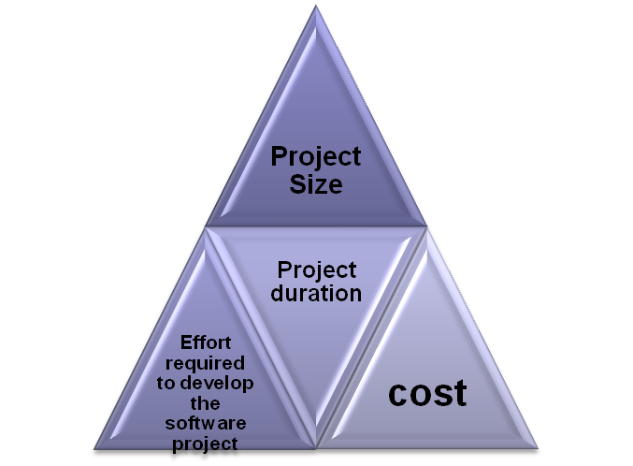
Empirical Estimation Techniques
Empirical estimation techniques are based on making an educated guess of the project parameters.
While using this technique, prior experience with development of similar products is helpful.
Although empirical estimation techniques are based on common sense, different activities involved in estimation have been formalized over the years.
Two popular empirical estimation techniques are:
Expert judgment technique and Delphi cost estimation.
Nilina Bera

Slide 36
Expert Judgment Technique
Expert judgment is one of the most widely used estimation techniques.
In this approach, an expert makes an educated guess of the problem size after analyzing the problem thoroughly.
Usually, the expert estimates the cost of the different components (i.e. modules or subsystems) of the system and then combines them to arrive at the overall estimate.
However, this technique is subject to human errors and individual bias.
Also, it is possible that the expert may overlook some factors inadvertently.
Further, an expert making an estimate may not have experience and knowledge of all aspects of a project.
For example, he may be conversant with the database and user interface parts but may not be very knowledgeable about the computer communication part.
Nilina Bera

Slide 37
Delphi cost estimation
Delphi cost estimation approach tries to overcome some of the shortcomings of the expert judgment approach.
Delphi estimation is carried out by a team comprising of a group of experts and a coordinator.
In this approach, the coordinator provides each estimator with a copy of the software requirements specification (SRS) document and a form for recording his cost estimate.
Estimators complete their individual estimates anonymously and submit to the coordinator.
In their estimates, the estimators mention any unusual characteristic of the product which has influenced his estimation.
The coordinator prepares and distributes the summary of the responses of all the estimators, and includes any unusual rationale noted by any of the estimators. Based on this summary, the estimators re-estimate.
This process is iterated for several rounds.
After the completion of several iterations of estimations, the coordinator takes the responsibility of compiling the results and preparing the final estimate.
Nilina Bera

Slide 38
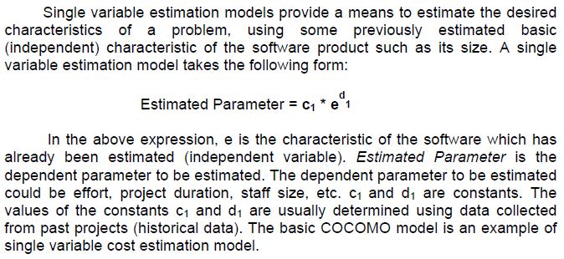
Heuristic Techniques
Heuristic techniques assume that the relationships among the different project parameters can be modeled using suitable mathematical expressions.
Once the basic (independent) parameters are known, the other (dependent) parameters can be easily determined by substituting the value of the basic parameters in the mathematical expression.
Different heuristic estimation models can be divided into the following two classes: single variable model and the multi variable model.
Nilina Bera

Slide 39
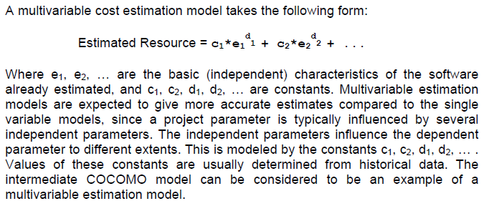
Software Estimation
Nilina Bera

Slide 40
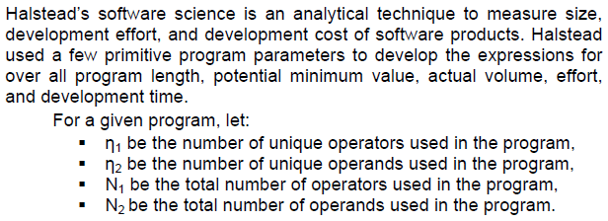
Analytical Estimation Techniques
Analytical estimation techniques derive the required results starting with basic assumptions regarding the project. Thus, unlike empirical and heuristic techniques, analytical techniques do have scientific basis. Halstead’s software science is an example of an analytical technique.
Halstead’s Software Science – An Analytical Technique
Nilina Bera

Slide 41
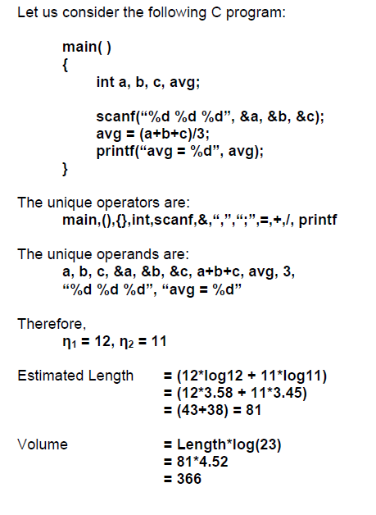
Nilina Bera

Slide 42

Nilina Bera

